Slide 1
SWIFTLOG LOGISTICS LIMITED | MISSION ML05
Machine learning, analytics and operations
Consolidated insights, visuals and recommendations
CREATED BY
Innocent Mphahlele
AnalystLab Africa –Machine Learning Internship | 18 October 2026
Notes:
Created by Innocent Mphahlele.

Slide 2
Executive summary: monitor now, predict once data improves
0 of 4
64%
~101 mo.
2
ML models beat their naive baseline
of shipments late, network-wide
of stock cover vs recent shipments
live dashboards (Streamlit + HTML)
We built, tuned and tested four prediction models (delay, returns, customer value, demand) on unseen future data; none beat a simple baseline. The outcomes are statistically unrelated to what SwiftLog records today.
Lateness is a company-wide process problem: no warehouse, city or order type is significantly worse.
Data gaps block value: no supplier link, no promised delivery date or event timestamps, no capacity figures, contradictory order statuses, duplicate inventory records.
What works now: live monitoring dashboards with alerts, warehouse capacity KPIs and a clear data-capture roadmap.
Notes:
Headline first: the honest answer is that prediction is not yet viable, and the path to fix it is clear.

Slide 3
Scope and approach: six problems, one safe pipeline
Delivery delay
Product return
Customer value
Classification | Built
Classification | Built
Regression | Built
Demand forecast
Supplier reliability
Warehouse performance
Regression | Built
Simulated link | Method only
Stats + capacity KPIs | Dashboard
1
2
3
4
5
Audit and join 11 tables
Engineer leakage-safe features
Split by time 70/15/15
Tune 5-6 algorithms
Test once vs baseline with 95% CI
Bar for "useful": beat a naive baseline with a confidence interval that excludes it. Accuracy alone is never trusted.

Slide 4
Data audit: data structure explains the results
64%
9.5%
236
1,545
late (3+ days)
orders returned
orders with no line items
duplicate warehouse-product stock records
Leakage trap: Delivery_Performance status is a rule of delay days, so using it gives a fake 100% score.
Order status contradicts reality: cancelled orders still ship and get returned at normal rates.
No supplier key and no warehouse capacity fields exist anywhere in the source tables.
Only eight full months of history (data ends 8 Sep 2026), so seasonality cannot be learned.
No promised delivery date, carrier, route or event timestamps, the likeliest true drivers of delay.

Slide 5
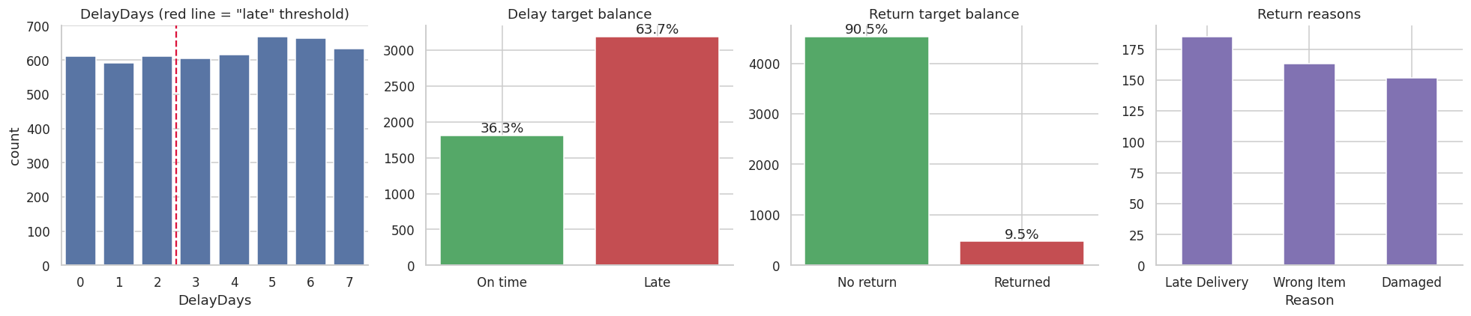
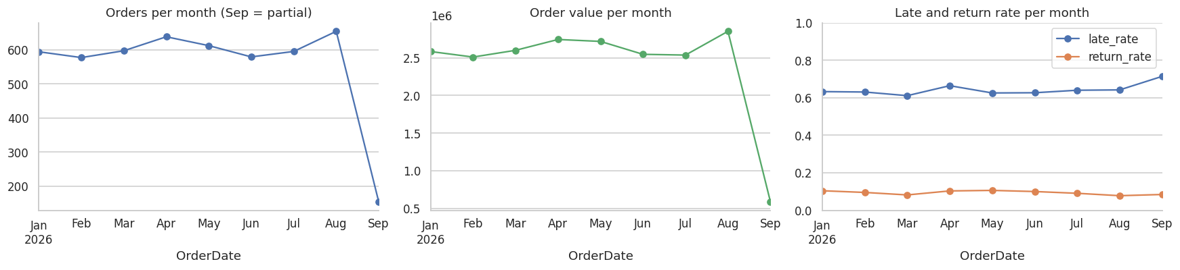
EDA: uniform delays, rare returns, flat trends
Delays are uniform (64% late); returns are 9.5%; monthly trends are flat; September is partial.

Slide 6
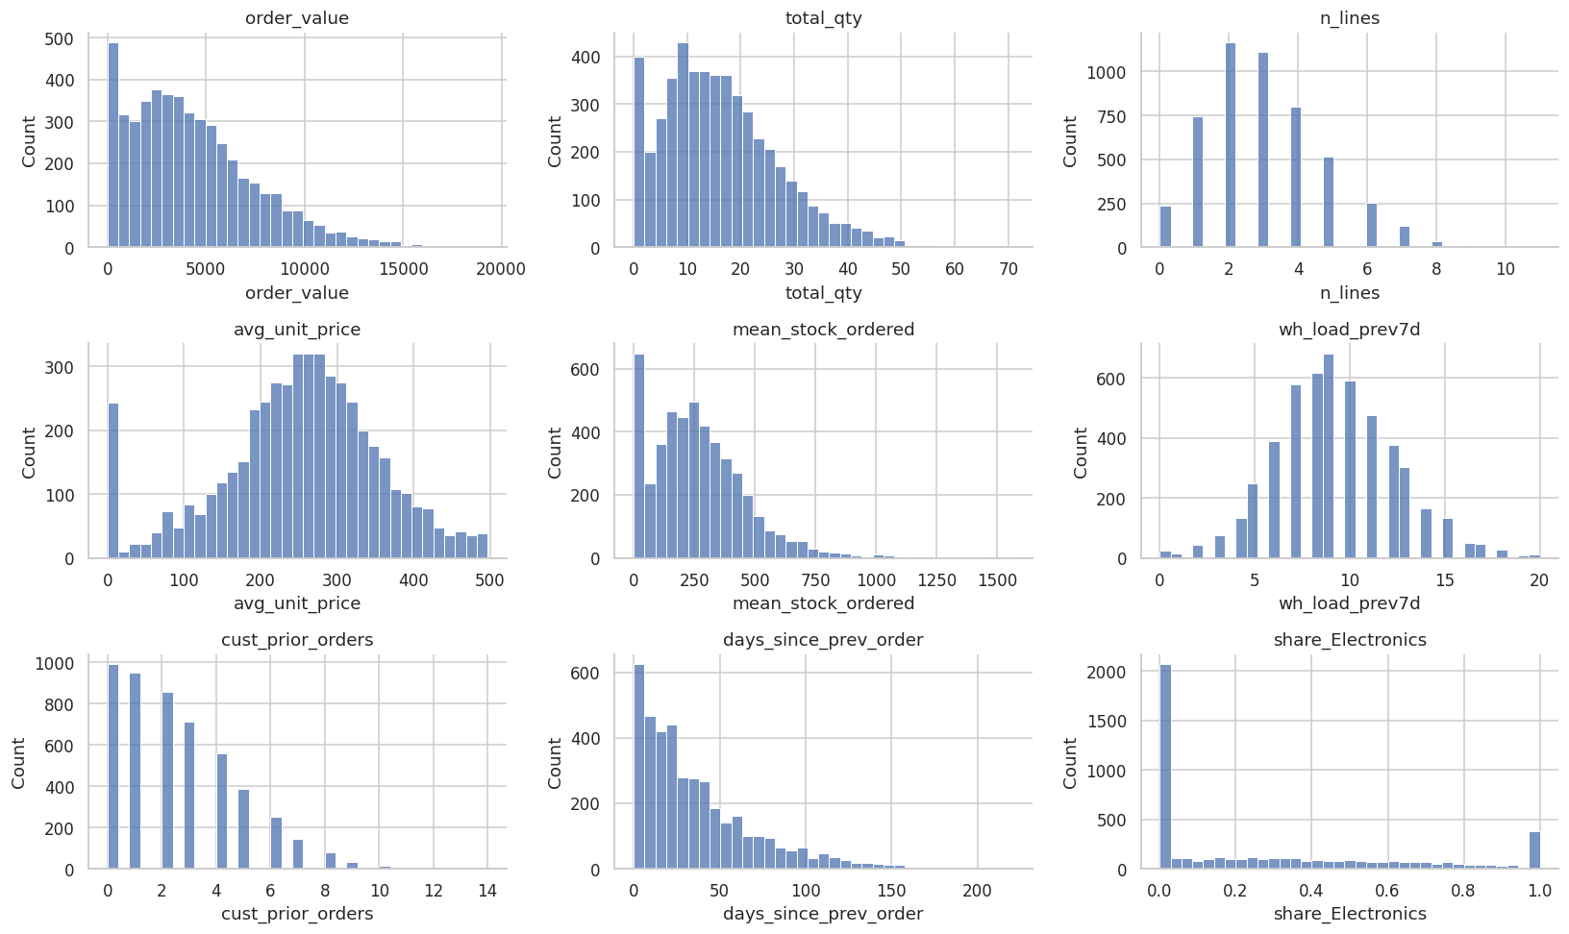
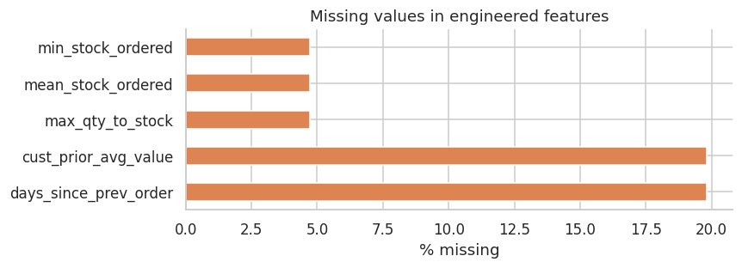
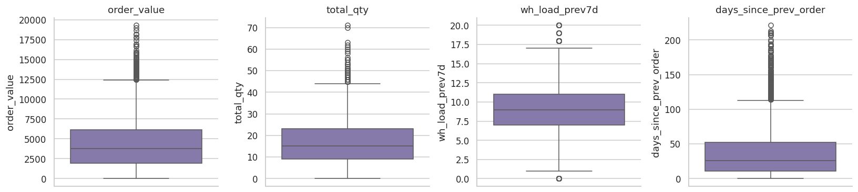
EDA: data quality is structural, not random
What we saw
Missing values arise only from joins: 236 orders without items (4.7%) and first-order history gaps.
Skewed distributions and large baskets are genuine, so outliers were kept.
Handled inside pipelines: median imputation, one-hot encoding, scaling for linear models only.

Slide 7
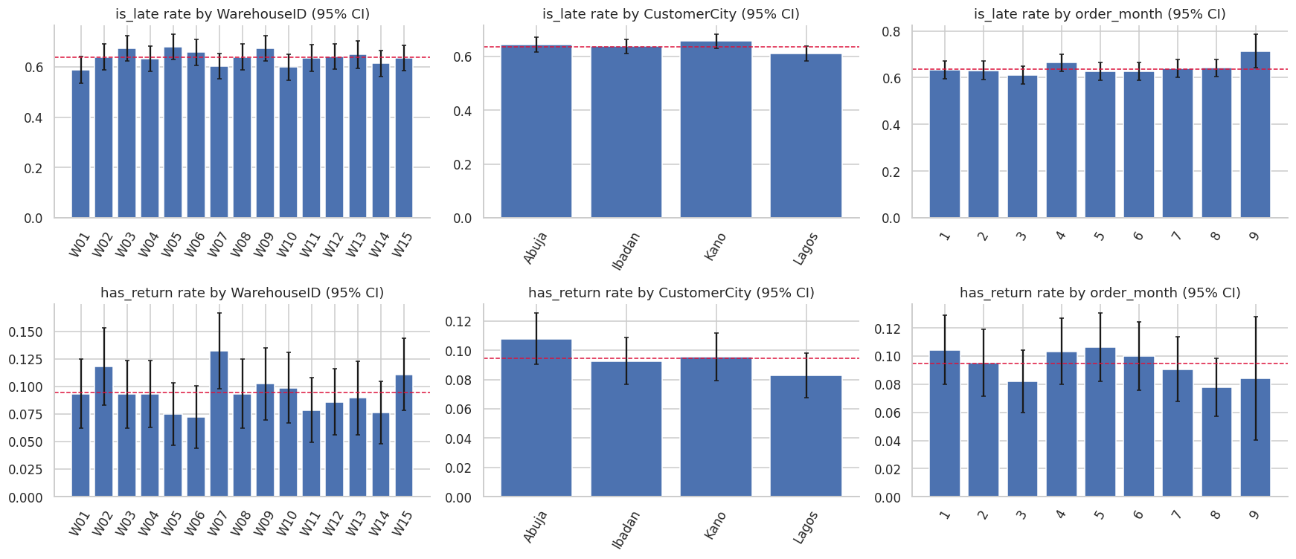
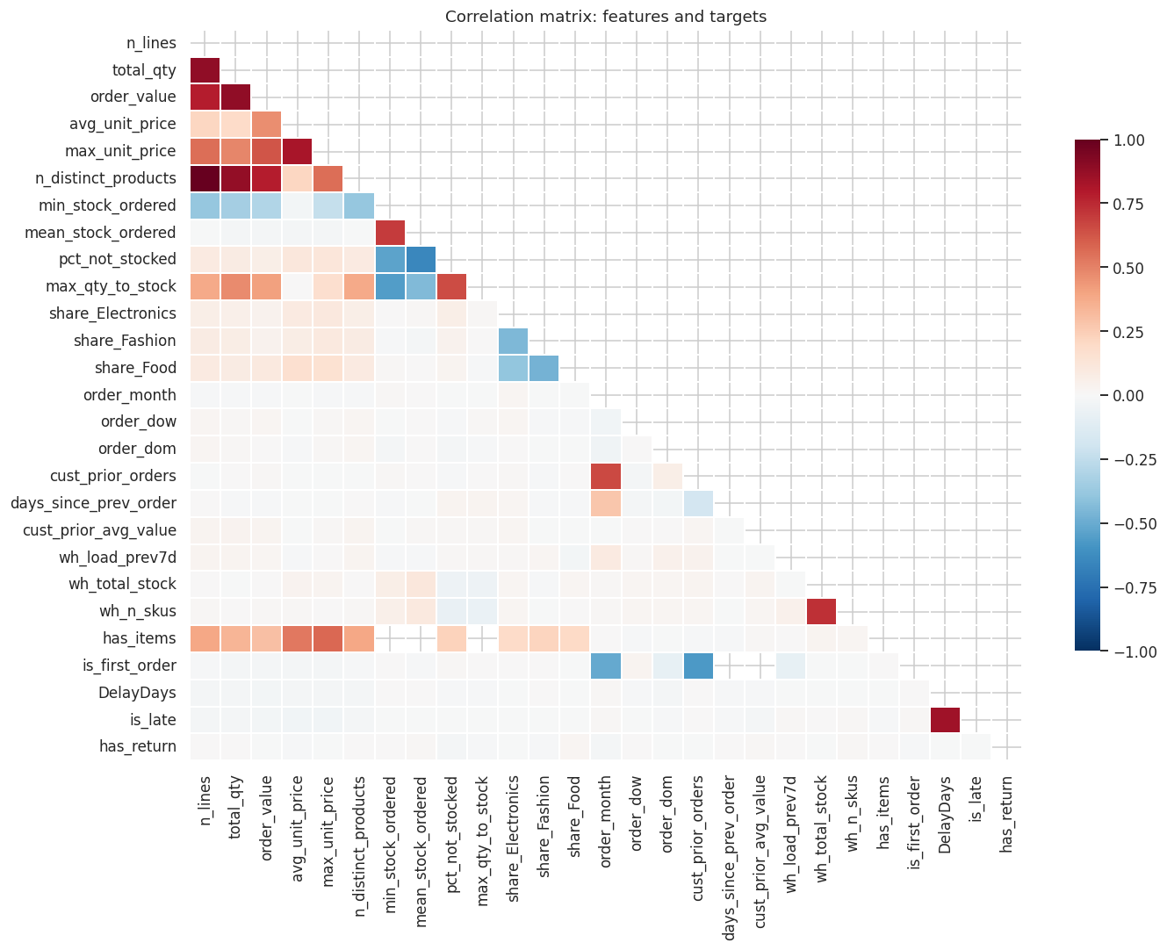
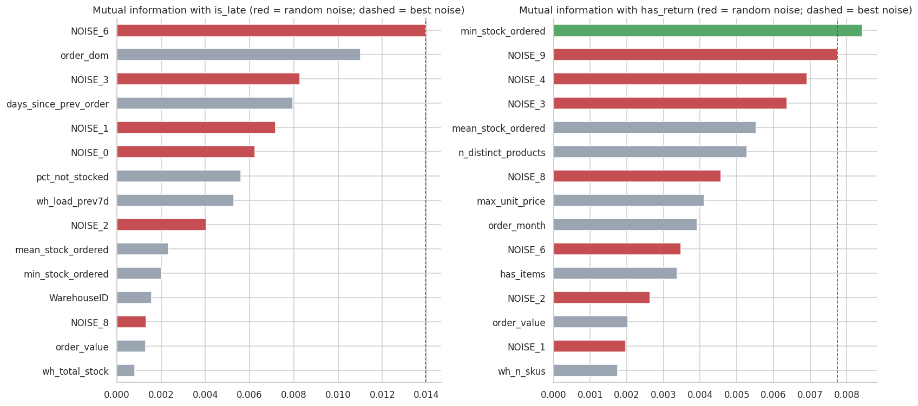
EDA: features show no link to the targets
What we saw
No meaningful correlation with late or returned.
Late and return rates do not differ by warehouse, city, month or weekday (all p above 0.05).
Mutual information barely beats random-noise columns, an early warning for the models.

Slide 8
Model scorecard: nothing beats its baseline
Problem | Best model | Metric | Test | Baseline | 95% CI | Verdict
Delivery delay | Decision Tree | ROC-AUC | 0.522 | 0.500 | 0.477 to 0.565 | No meaningful signal
Product return | Decision Tree | ROC-AUC | 0.526 | 0.500 | 0.440 to 0.604 | No meaningful signal
Customer value | Random Forest | R-squared | -0.030 | 0.000 | -0.080 to -0.015 | No meaningful signal
Demand forecasting | Linear Regression | R-squared | -0.092 | 0.000 | -0.161 to -0.039 | No meaningful signal
Supplier (SIMULATED link) | Logistic Regression | ROC-AUC | 0.424 | 0.500 | 0.233 to 0.616 | No meaningful signal
AUC 0.50 is a coin flip; R-squared below 0 is worse than predicting the average. Delay and return intervals include 0.50; customer-value and demand intervals sit entirely below 0. Delay accuracy also falls below the "always late" rule (65.5% on the test period).

Slide 9
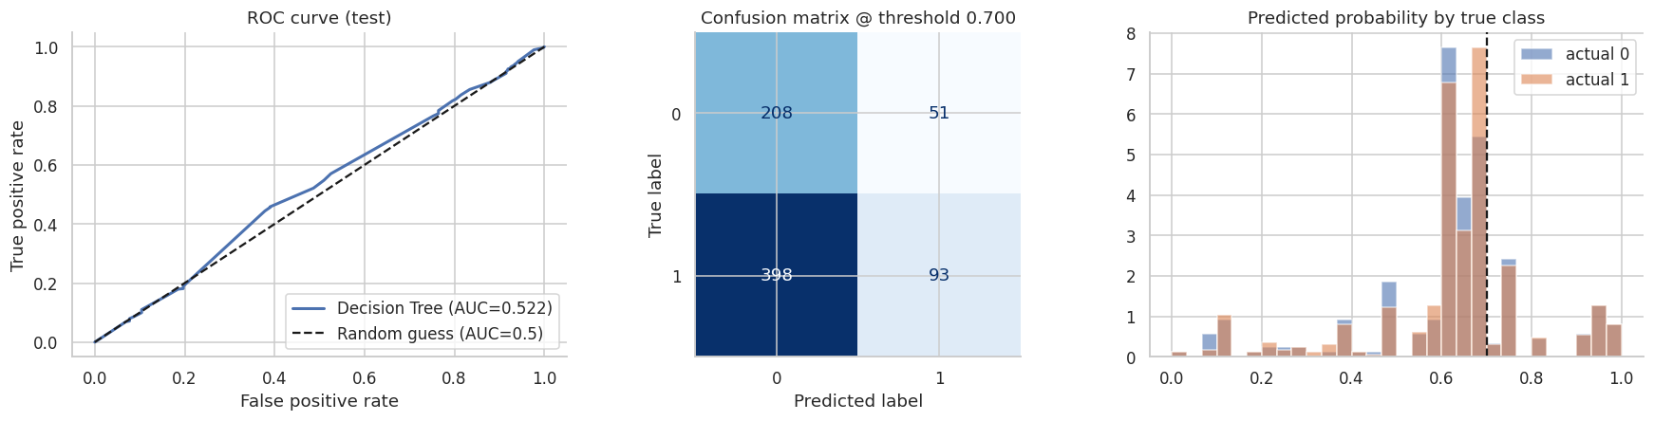
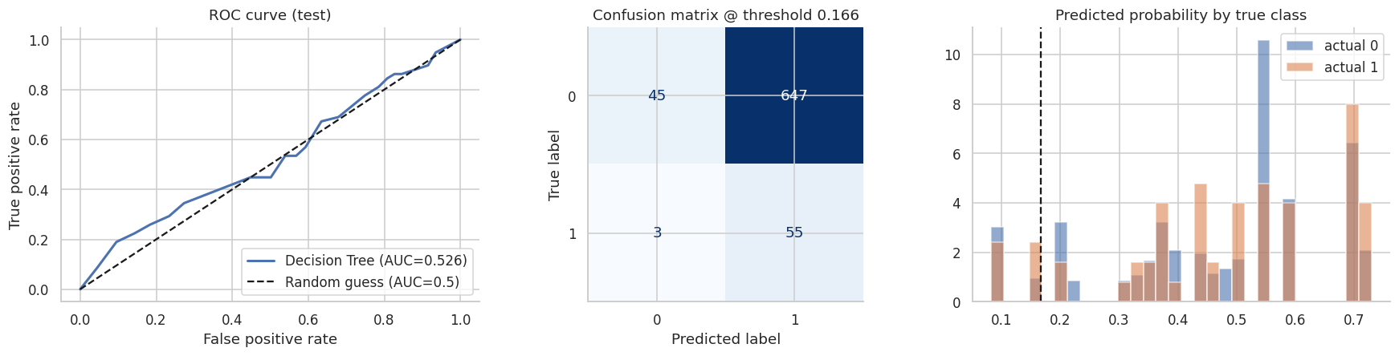
Diagnostics: delay and return models hug the diagonal
Reading the plots
ROC curves sit on the random-guess line.
Predicted-probability distributions for late and on-time orders overlap almost completely.
Returns show the accuracy paradox: 92% accuracy by predicting "no return" while catching none.

Slide 10
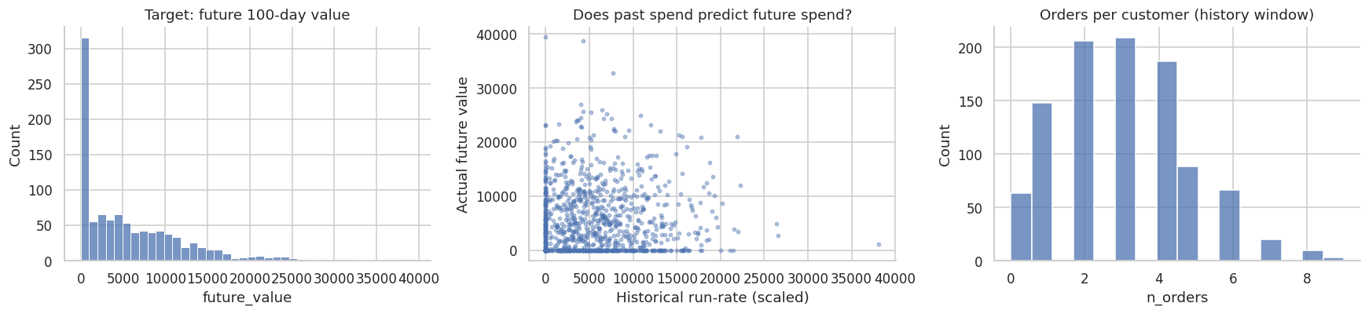
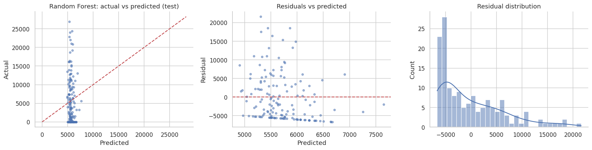
Customer value: past spend does not predict future spend
Reading the plots
Past and future spend correlate at about 0.00.
Predictions do not track actuals; R-squared is -0.03.
Top-20% targeting captures 11.5% of value, below random (20%) and the run-rate rule (14.6%).

Slide 11
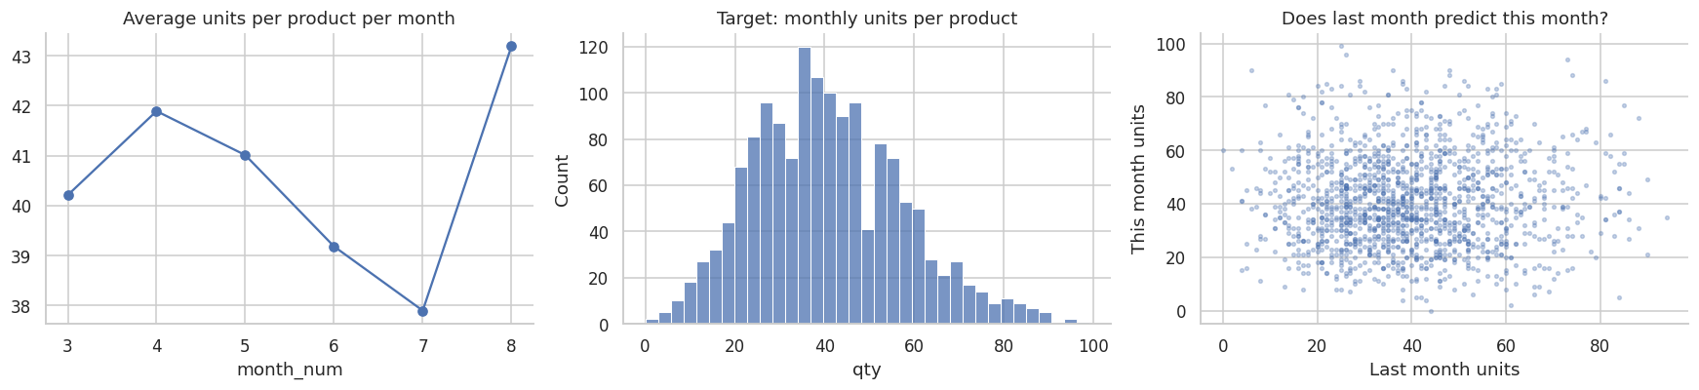
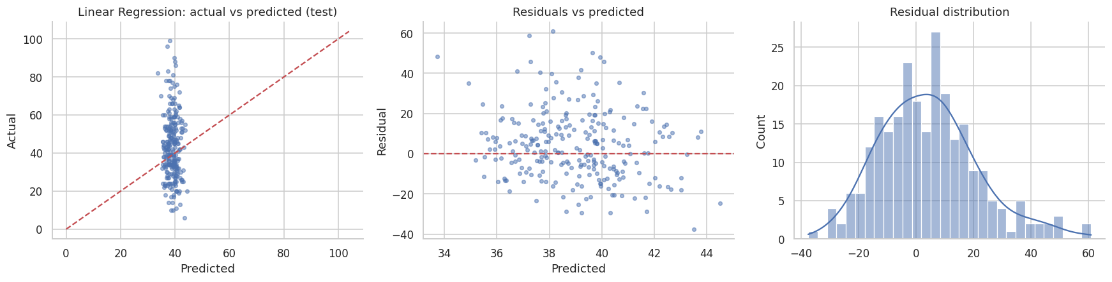
Demand: monthly units are noise around a stable mean
Reading the plots
About 41 units per product-month (std about 17).
Last month explains almost nothing about this month (correlation 0.03).
Best model R-squared -0.09; naive forecasts do no better, so use safety-stock rules.

Slide 12
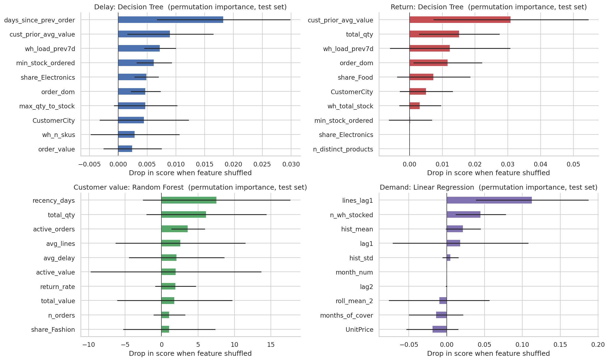
Feature importance is tiny and indistinguishable from zero
What it means
Permutation importance on the test set with 20 repeats.
For three models all top-10 features lie within 2 standard deviations of zero; for delay, 7 of 10.
Rankings describe what algorithms fitted to noise, not business drivers.

Slide 13
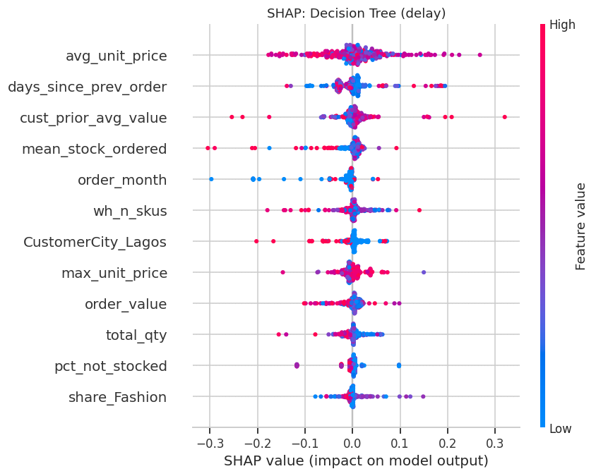
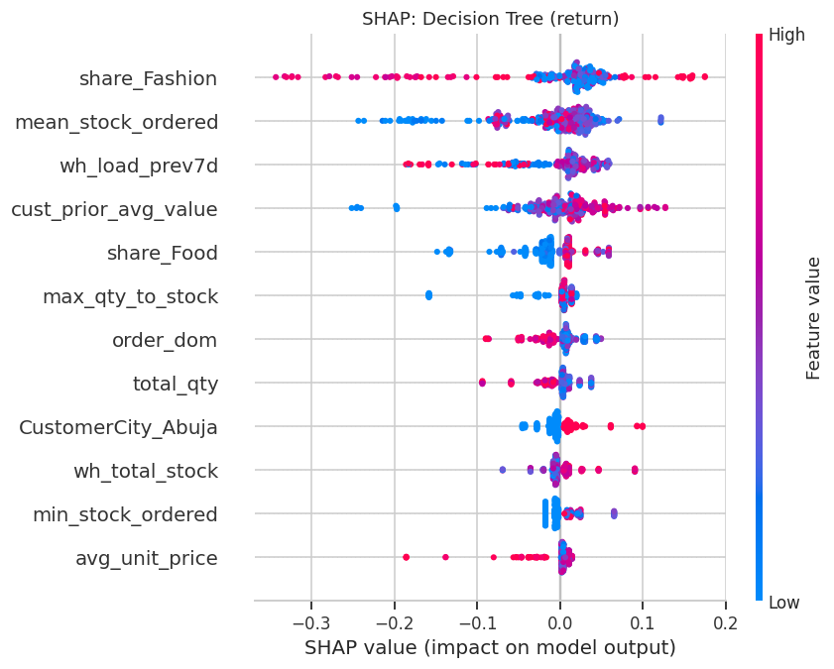
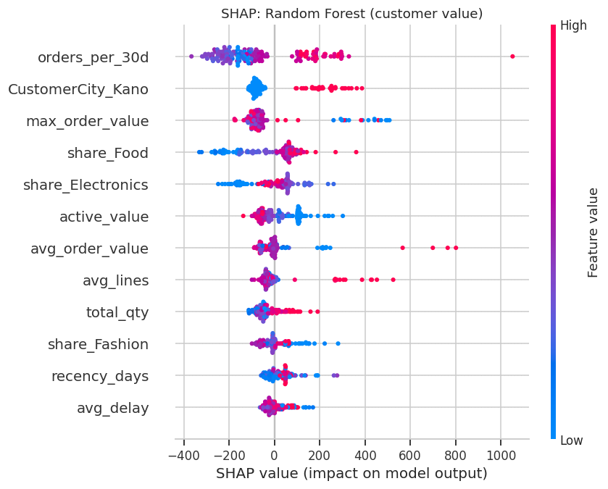
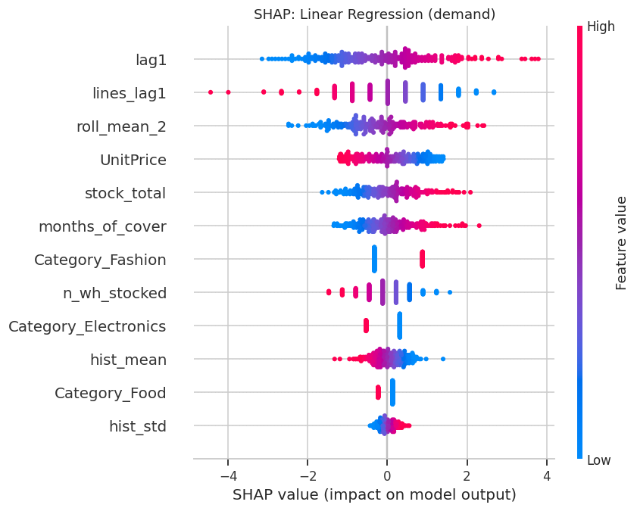
SHAP summaries agree: no coherent drivers
Reading SHAP
Top: delay and return. Bottom: customer value and demand.
Small, mixed-sign contributions with no stable pattern.
Explanations are only meaningful when a model has skill.

Slide 14
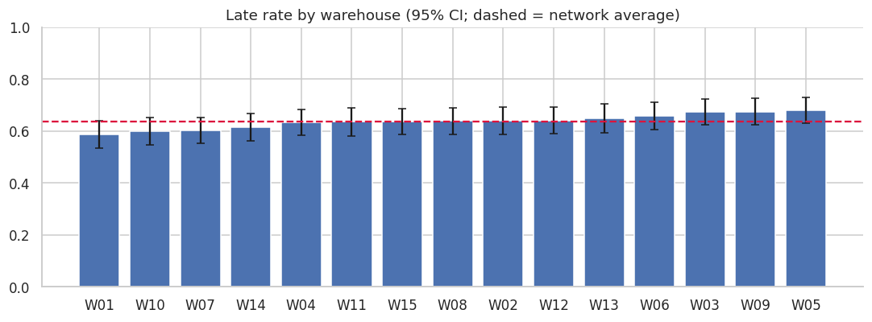
Warehouses: no site stands out; capacity is unmeasured
Late rate 58.7% to 68.0%; chi-square p = 0.33, ANOVA p = 0.76: differences are chance.
Stock, SKU count, volume: no link to late rate.
No capacity field exists. Throughput capacity is derived from each site's 90th-percentile week; storage capacity is an editable ASSUMPTION.
About 101 months of stock cover suggests overstock or a unit mismatch: validate.
1,007,764
70%
4 of 15
units in stock (15 sites)
throughput use, last 7 days vs P90 week
above 85% on storage or throughput (assumed cap.)

Slide 15
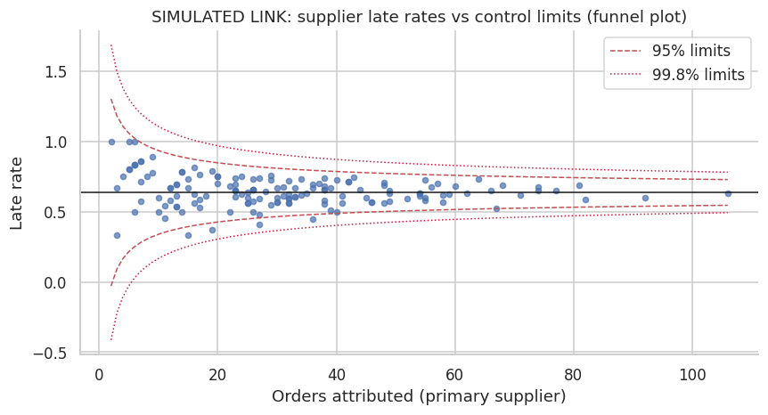
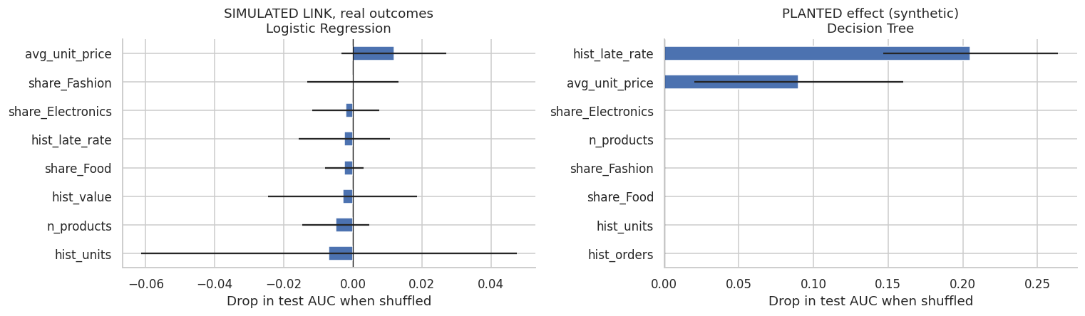
Supplier link is assumed: method validated, suppliers not
SIMULATED link
No real supplier key, so products were assigned to suppliers at random (seeded).
Real outcomes: no differences (p = 0.89; 4 of 150 outside limits vs about 7 expected).
Planted synthetic effect found: test AUC 0.75, led by historical late rate.
Never rank real suppliers with this.

Slide 16
Two cautionary tests: leakage and targeting
A perfect score is proof of leakage, not success. And the ML model ranks customers worse than a simple spend rule or even random choice.

Slide 17
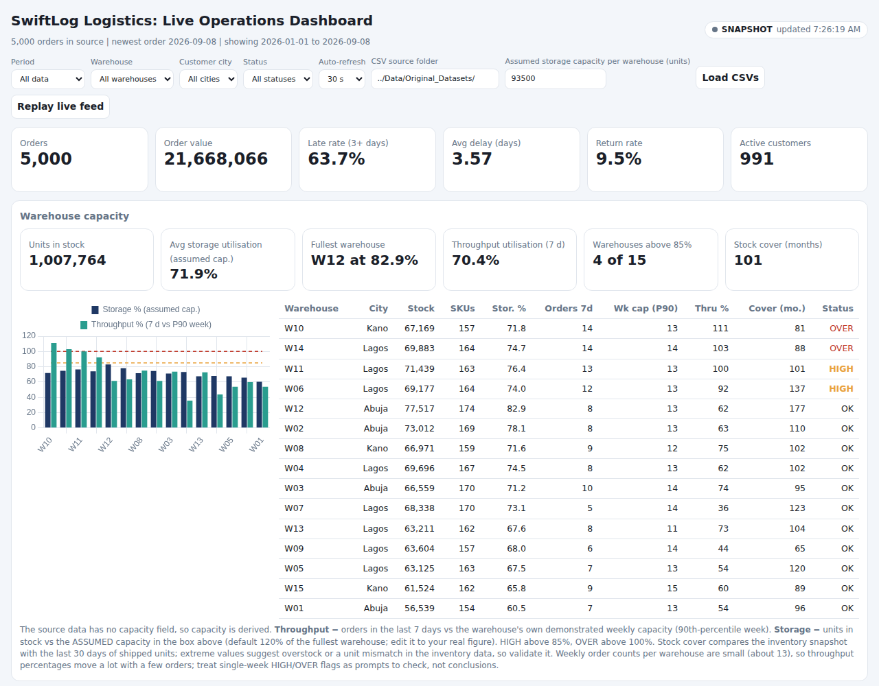
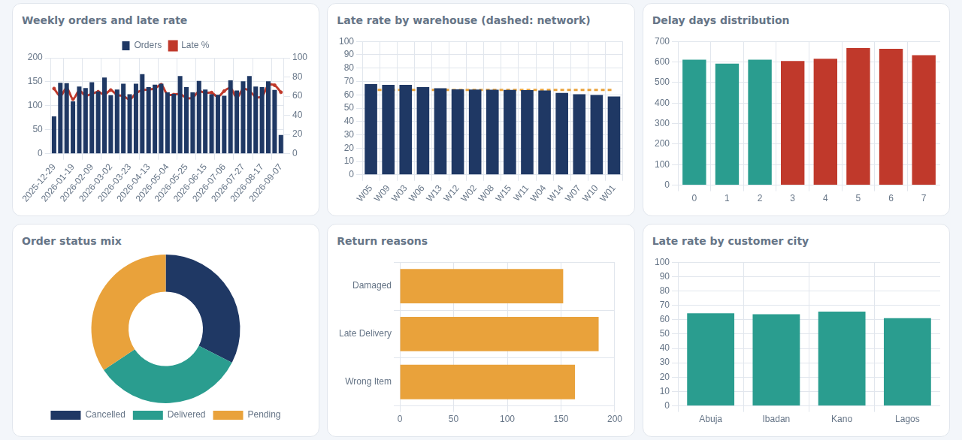
Live dashboards: monitoring, alerts and capacity KPIs
HTML dashboard: polls CSVs, loads new files, or replays history; hosted link available.
Streamlit dashboard: auto-refresh, inventory cover, model health.
KPIs with period deltas, filters, 99% control-limit alerts, capacity scorecard.
Monitors only; no predictions, since no model passes the skill gate.

Slide 18
All key insights at a glance
1
Lateness is network-wide
2
Returns are flat
64% late; no warehouse, city or month differs
9.5% everywhere; nothing flags risky orders
3
History does not predict value
4
Demand is noise around a mean
Past vs future spend correlation about 0.00
About 41 units per product-month
5
Leakage creates fake accuracy
6
Supplier performance is invisible
Delay days / status give 100% AUC
No key; method validated on simulated link
7
Warehouses are statistically alike
8
Stock looks extreme
p = 0.33 and 0.76; capacity unmeasured
About 101 months of cover vs recent shipments
9
Status and stock data are unreliable
10
Data, not algorithms, is the bottleneck
Contradictions, duplicates, items-less orders
Missing drivers cap any model

Slide 19
Fourteen recommendations in four groups
Capture the drivers
Fix data integrity
Operate smarter
Enrich and govern
Promised delivery date on every order
Event timestamps, carrier, route, distance
SupplierID plus PO and receipt dates
True warehouse capacity (positions, labour, shifts)
Enforce order-status rules
Dated, single-record inventory; explain ~101 months cover
Validate orders at entry (no empty orders)
Retire or repurpose the redundant delivery-performance table
Fix lateness centrally: SLAs, cut-offs, carriers
Monitor before predicting: dashboards and control limits
Safety-stock rules instead of ML forecasts
Returns reasons, condition, fault
Customer segment and contract data
Model gate: lower CI bound above 0.60 AUC or R-squared above 0.10

Slide 20
Improvements: delivered so far and what comes next
Delivered in this project
0-3 months
Fix data capture; hook dashboards to live feeds
Leakage-safe pipeline with chronological splits and baselines
95% confidence intervals and a deployment skill gate
ML console serving five models with warnings
Streamlit and HTML live dashboards, now with capacity KPIs
Supplier method validated with a planted effect
Reports, workbook and notebooks for full reproducibility
3-9 months
Re-run delay and return models; supplier scorecards
9-18 months
Seasonal demand, ETA prediction, inventory optimisation
18+ months
Optimise allocation, carriers and safety stock

Slide 21
CONCLUSION AND NEXT STEPS
Monitor now, capture the right data, and re-test prediction in 6-9 months.
Next 90 days: promised dates, timestamps, carrier, supplier IDs and true warehouse capacity
Run the live dashboards on scheduled data feeds and act on alerts
Re-run all models through the governance gate on the enriched data
Created by Innocent Mphahlele | AnalystLab Africa –Machine Learning Project

